Slide 1
Advantages of
Data Warehousing
Kyle Lahnakoski, November 2014

Slide 2
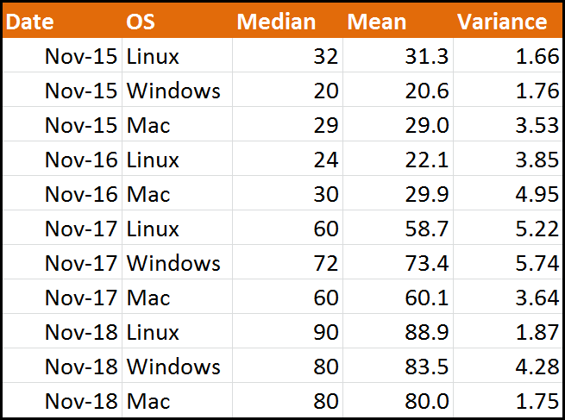
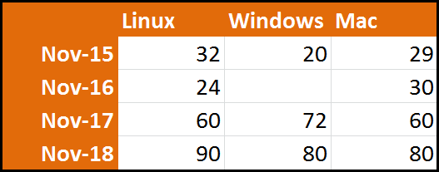
Nomenclature
Table / Relation
Cube / Pivot Table

Slide 3
Nomenclature
Column / Attribute
Dimension

Slide 4
Nomenclature
Column / Attribute
Dimension

Slide 5
Nomenclature
Values
Measure

Slide 6
Nomenclature
Values
Measure
Median

Slide 7
Nomenclature
Values
Measure
Mean

Slide 8
Nomenclature
Values
Measure
Variance

Slide 9
Nomenclature
Candidate Key
Coordinates

Slide 10
Nomenclature
Value
Fact

Slide 11
Benefits Summary
Fast* filtering (fast “slicing”)
Fast* aggregates
API is a query language (SQL, MDX)
A service, open to third party clients
Clean, Cartesian space of values
Metadata on dimensions and measures
Defines a standard for ETL
* Virtually O(1)

Slide 12
Benefits
Fast Slicing and Fast Aggregates
Data is de-normalized to avoid expensive joins
Creates and manages multiple indexes across many dimensions for fast slicing
Manages materialized views (pre-aggregated data) for fast aggregates

Slide 13
Benefits
API is a Query Language
MDX (via some wire protocol)
SELECT
[Measures].[Performance].[Mean] ON COLUMNS
FROM
[Talos]
WHERE
[OS].[Windows]
SQL (via ODBC?)
SELECT
AVG(Mean) AS Mean
FROM
Talos
GROUP BY
OS
WHERE
OS = “Windows”

Slide 14
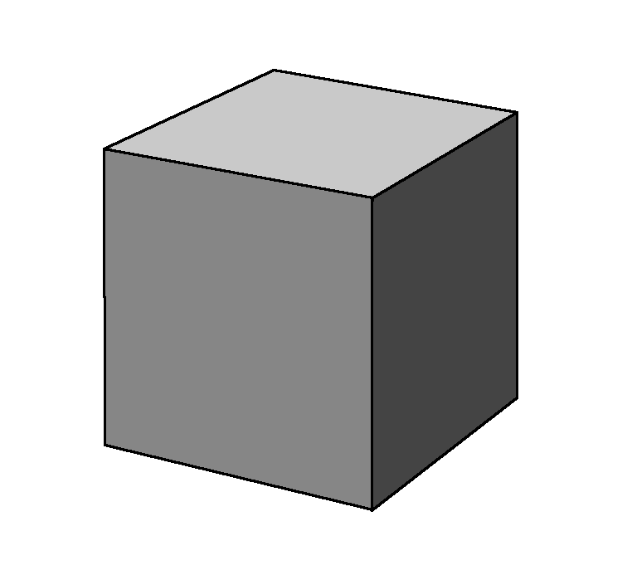
Benefits
API is a Query Language
Open to third party clients
Data Warehouse

Slide 15
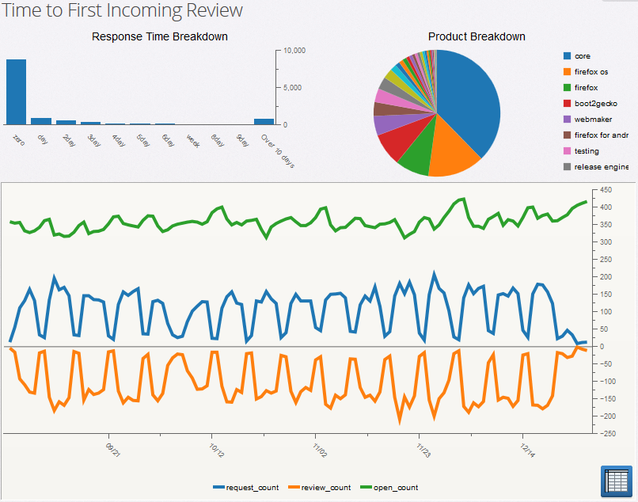
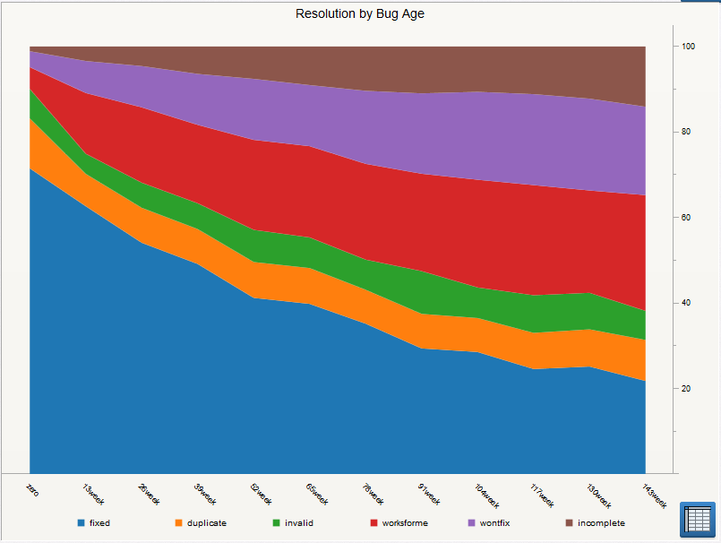
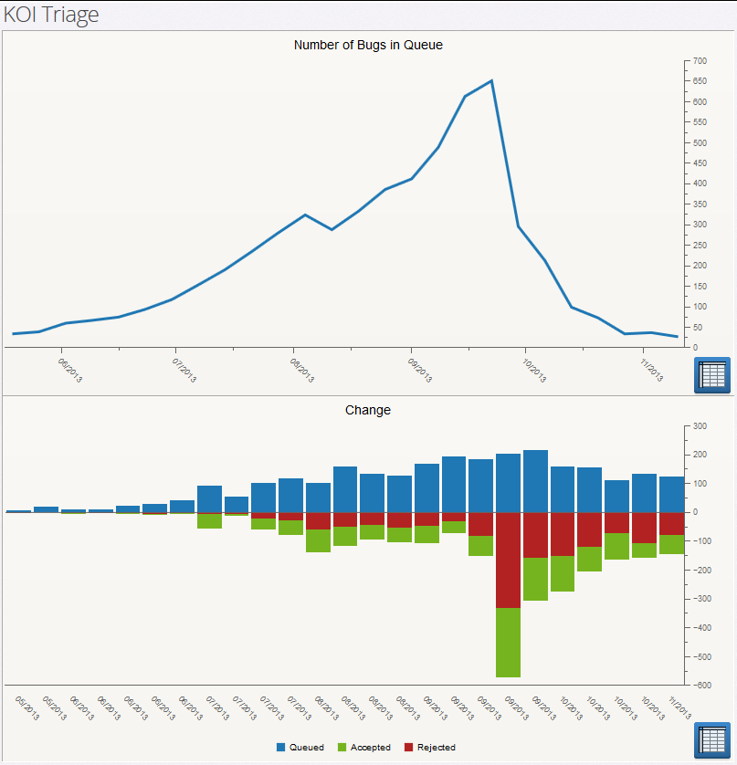
Benefits
API is a Query Language
Open to third party clients
Dashboards
Data Warehouse

Slide 16



Benefits
API is a Query Language
Open to third party clients
Dashboards
Analysis Tools
Data Warehouse

Slide 17
Benefits
API is a Query Language
Open to third party clients
More expressive than standard RESTful APIs
SELECT
*
FROM
bugs
WHERE
whiteboard.contains(“[js:p1]”) AND
component.beginsWith(“javascript”)
SQL
https://bugzilla.mozilla.org/buglist.cgi?
f1=status_whiteboard&
o1=substring&resolution=---&
o2=substring&query_format=advanced&
f2=component&v1=[js%3Ap1]&
v2=javascript
Bugzilla

Slide 18
Benefits
API is a Query Language
Open to third party clients
More expressive than standard RESTful APIs
Saves developer from implementing query features for third party apps.

Slide 19
Benefits
API is a Query Language
Open to third party clients
More expressive than standard RESTful APIs
Saves developer from implementing query features for third party apps.
High demand on DW service
No joins – upper bound on cost of a request
Only filter and aggregates
Security model is required

Slide 20
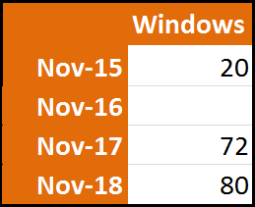
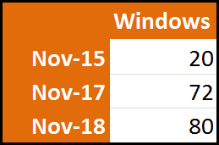
Benefits
Clean, Cartesian spaces
Dimension members are represented once
SELECT
[Date] ON ROWS
[Measures].[Median] ON COLUMNS
FROM
[Talos]
WHERE
[OS].[Windows]
MDX
SELECT
Date,
AVG(Median) AS Median
FROM
Talos
GROUP BY
OS
WHERE
OS = “Windows”
SQL

Slide 21
Benefits
Clean, Cartesian spaces
Dimension members are represented once
SELECT
[Date] ON ROWS
[Measures].[Median] ON COLUMNS
FROM
[Talos]
WHERE
[OS].[Windows]
MDX
Where’s the 16th?
SELECT
Date,
AVG(Median) AS Median
FROM
Talos
GROUP BY
OS
WHERE
OS = “Windows”
SQL

Slide 22
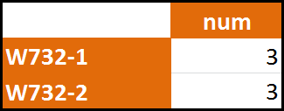
Benefits
Clean, Cartesian spaces
Dimension members are represented once
and only once
SELECT
m.name,
COUNT(t.Median) AS num
FROM
Talos t
JOIN
Machines m on m.os=t.os
GROUP BY
m.Name
WHERE
OS = “Windows”

Slide 23
Benefits
Clean, Cartesian spaces
Dimension members are represented once
and only once
SELECT
m.name,
COUNT(t.Median) AS num
FROM
Talos t
JOIN
Machines m on m.os=t.os
GROUP BY
m.Name
WHERE
OS = “Windows”
Bad logic, wrong assumption

Slide 24
Benefits
Clean, Cartesian spaces
Dimension members are represented once
and only once
SELECT
m.name,
COUNT(t.Median) AS num
FROM
Talos t
JOIN
Machines m on m.os=t.os
GROUP BY
m.Name
WHERE
OS = “Windows”
May conclude there are 6 tests

Slide 25
Benefits
Clean, Cartesian spaces
Dimension members are represented once
and only once
Dimensions are orthogonal (no functional dependencies)

Slide 26
Benefits
Metadata on Dimensions and Measures
Dimensions can have sub-dimensions, type, name, natural ordering, formatting
Measures have measurement units, default aggregation
Extra context allows for exploration

Slide 27
Benefits
Defines a standard for ETL
Databases provide too much design choice:
You can choose to de-normalize for speed, or
Stay normalized for low selectivity relations.
Make a specific index, or
Write code to manage a fast aggregate.

Slide 28
Benefits
Defines a standard for ETL
Databases provide too much design choice:
You can choose to de-normalize for speed, or
Stay normalized for low selectivity relations.
Make a specific index, or
Write code to manage a fast aggregate.
Shape of the data in a database can be more complicated than the data demands. It can include side effects of implementation decisions.

Slide 29
Benefits
Defines a standard for ETL
Databases provide too much design choice
DW takes away choices of data layout:
Always de-normalize
Redundant, even when extreme
Indexing decisions are made by the warehouse, not you.

Slide 30
Benefits
Defines a standard for ETL
Databases provide too much design choice
DW takes away choices of data layout
DW demands all data is centralized
No deciding which system it best be in
Demands data that can be cross-referenced

Slide 31
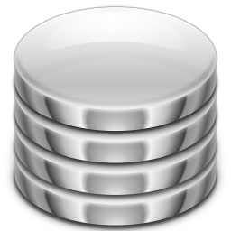
Benefits
Defines a standard for ETL
Mercurial
Bugzilla
Data Warehouse
Buildbot
Talos

Slide 32
Data Warehouse?
Do you need a Data Warehouse?
Are you caching?
cache filtered results
writing materialized views
managing materialized views (caching aggregates)
Are you indexing? (for query optimization)
Are you joining? (and delivering long result sets)
Are you building a query interface?
Can you accept “eventual consistency”?
Are you doing these all happening in a recognizable section of your code? - You need a data warehouse, or at least use it’s abstractions.

Slide 33
Data Warehouse?
Data warehouse is more than a NoSQL columnar data store:
DW provides a query language with fast slices and aggregates
DW includes extra metadata, how dimensions relate to each other and about the measures.
NoSQL data stores make an excellent base for data warehousing, but require additional work

Slide 34
Data Warehouse?
Existing Solutions?
Open Source is about 20 years behind commercial software.
Underlying Open Source technology is well developed, but the integration is non-existent.
Good solutions are commercial solutions - Metrics uses Vertica and Tableau – both commercial products.
Business Intelligence is very profitable: Open Source solutions disappear:
Pentaho – Went from subscription model to multi-license model (~July 2009?).
Mozilla was working with WebDetails, now bought by Pentaho.

Slide 35
Data Warehouse?
No Existing Solutions?
Mozilla may be unique:
BI is a means to an ends – We may be the first truly open company with BI needs.
We have mandate to be open
We can define the integration standards
With standards, we can work with community and amplify each others skill

Slide 36
Data Warehouse?
Data Warehouse as Abstraction
Dictate the two main DW standards:
Input - Multidimensional data cube
Output – Fast query service
ETL designed to fill data cubes
Clients leverage service to simplify internal design
Tool discovery and software optimization for the data warehouse is independent of the peripheral software that uses it.

Slide 37
Costs
Data Warehouse as Abstraction
ETL is significant work
Security model

Slide 38
Data Warehouse?
Example
Python
Javascript
Elasticsearch

Slide 39
Data Warehouse?
Query API

Slide 40
Beyond Data Warehousing
Hierarchal database (no) are free

Slide 41
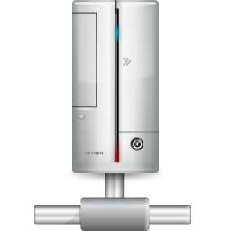


Architecture
web/file server
ajax
Browser
ETL
Bugzilla DB
Elasticsearch

Slide 42
The End

